Slide 1
SECTION
05
Financial performance
Chargeable hours and the profit they produce
Notes:
Chargeable hours and the profit they produce

Slide 2

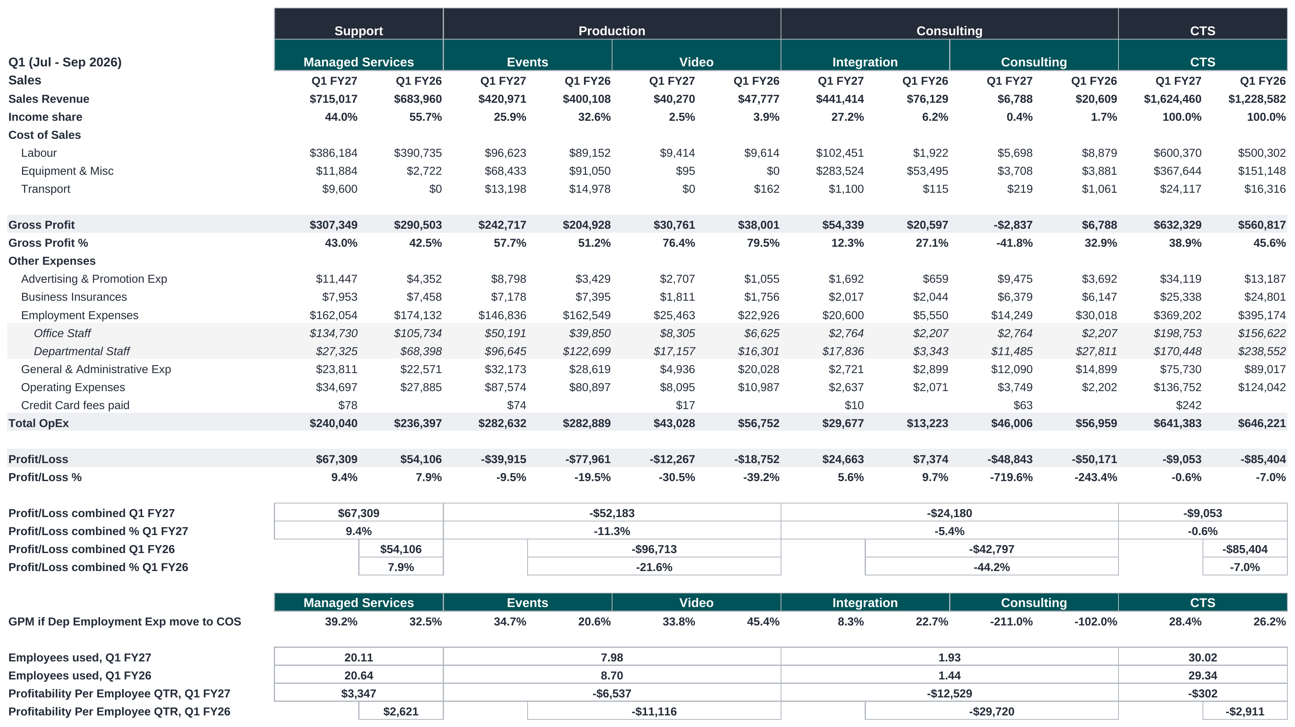
FINANCIAL PERFORMANCE|FY27 Q1 DEPARTMENT FY26 AND FY27 Q1 COMP
COMMENTARY
Revenue was $1,624,460 for the quarter against $1,228,582, up 32.2%.
Gross profit was $632,329 against $560,817, but the margin fell from 45.6% to 38.9%.
Integration drove it, $441,414 against $76,129, at a 12.3% margin.
Support is the only department in profit after overheads, $67,309.
Production lost $52,183 and Consulting $24,180.
The group lost $9,053, against a loss of $85,404 last year.
Profit per FTE: Support $3,347, Production -$6,537, Consulting -$12,529.
Notes:
Revenue for the first quarter was $1,624,460 against $1,228,582 last year, $395,878 more, up 32.2%.
Gross profit was $632,329 against $560,817. So revenue grew a long way faster than gross profit, and the margin came down from 45.6% to 38.9%.
Support had the steady quarter. It is the only department that makes a profit once overheads are on it, $67,309 for the quarter against $54,106 last year.
Production improved its margin, Events from 51.2% to 57.7%, but it still finishes at a loss of $52,183 after overheads, against $96,713 last year.
Consulting is where the growth is. Integration revenue was $441,414 against $76,129. The margin on it is 12.3%, so the volume is large and the gross profit on it is small. After overheads Consulting loses $24,180.
That one department is the reason the group margin fell.
The group lost $9,053 for the quarter, against a loss of $85,404 last year. So we are close to breakeven and a long way better than last year.
Profit per full time equivalent was $3,347 in Support, -$6,537 in Production and -$12,529 in Consulting.
If you are asked: last year had no departmental overhead split, so the FY26 half of this table is the published FY26 report, pasted in. The employee counts are full time equivalents off labour hours, the same basis the old report used, so the two years compare.

Slide 3
SECTION
05
People and utilisation
Chargeable hours and the profit they produce
Notes:
Chargeable hours and the profit they produce

Slide 4
PEOPLE AND UTILISATION | FY27 Q1 - UTILISATION PER EMPLOYEE
COMMENTARY
Support ran 6,942 chargeable hours against 393 non-chargeable, 95% of hours worked.
Production billed 954 hours against 1,150 non-chargeable, so over half its worked time was not billed.
Consulting is the same shape on a smaller base, 179 against 280.
Leave took 1,258 hours across the quarter, 543 of it in Production.
Across CTS the quarter ran 8,074 chargeable hours against 1,823 non-chargeable, 62% chargeable against an 82% target.
Notes:
Support ran 6,942 chargeable hours against 393 non-chargeable, 95% of hours worked.
Production billed 954 hours against 1,150 non-chargeable.
Consulting is the same shape on a smaller base, 179 against 280.
Leave took 1,258 hours across the quarter, 543 of it in Production.
Across CTS the quarter ran 8,074 chargeable hours against 1,823 non-chargeable.

Slide 5
PEOPLE AND UTILISATION | UTILISATION PER DEPARTMENT – Q1 FY27
COMMENTARY
Video, Integration and Consulting are small on hours. 75, 108 and 65 billed.
Consulting billed 65 hours against 280 not billed, the weakest ratio on the page.
Leave was 1,258 hours for the quarter, 646 of it in Support and 543 in Events.
Support does nearly all the billable work. 6,966 hours of the 8,073 billed across CTS.
Events is the opposite shape. 860 hours billed against 1,067 not billed.
So Events spent more time unbilled than billed, on about one eighth of Support’s billable hours.
Notes:
The single message is that Support is carrying the billable work almost on its own. Support billed 6,966 hours. Everyone else combined billed 1,108.
Events is the one to talk about. It billed 860 hours and did not bill 1,067. More time went unbilled than billed. That is the hours picture behind the Production result on slide 18, where Production billed 461k and still lost money after overhead.
Consulting is the same shape on a much smaller base. 65 hours billed against 280 not billed.
Leave took 1,258 hours out of the quarter. Support and Events account for 1,189 of it.
If asked how this squares with slide 29, the answer is that it is the same quarter on a five way split instead of three. The totals agree. Billable 8,073 here against 8,074 there, leave 1,258 on both. About 23 hours sit in a different department between the two cuts.

Slide 6
PEOPLE AND UTILISATION | ROLLING (OCT 2025 TO - UTILISATION PER EMPLOYEE
COMMENTARY
Support carries the business. 23,902 chargeable hours against 387 non-chargeable, 89.7% chargeable against an 88% target. Twelve of its sixteen people are over target.
Production bills less than half its time. 3,901 chargeable against 4,143 non-chargeable, 41.6% against a 67.2% target. All five people are under.
Blake Crisford is furthest off at 37.2% against a 70% target, and carries 483 hours of leave, the most of anyone.
Consulting is one person at 22.9% against a 50% target, 461 chargeable hours against 1,293 non-chargeable.
Leave runs to 4,131 hours across the year, 1,449 of it in Production
Across CTS the forecast is 28,264 chargeable against 5,823 non-chargeable. 74.3% chargeable against an 80.8% target, 6.6 points under.
Notes:
Support ran 6,942 chargeable hours against 393 non-chargeable, 95% of hours worked.
Production billed 954 hours against 1,150 non-chargeable.
Consulting is the same shape on a smaller base, 179 against 280.
Leave took 1,258 hours across the quarter, 543 of it in Production.
Across CTS the quarter ran 8,074 chargeable hours against 1,823 non-chargeable.

Slide 7
PEOPLE AND UTILISATION | ROLLING UTILISATION PER DEPARTMENT|OCT 25 TO SEP 2026
COMMENTARY
Support does nearly all the billable work. 23,902 hours of the 28,264 billed across CTS.
Support has almost no unbilled time. 387 hours against 23,902 billed, under 2% of what it worked.
Production is the opposite shape. 3,901 hours billed against 4,143 not billed.
Consulting is the weakest ratio on the page. 461 billed against 1,293 not billed, nearly three times as much unbilled as billed.
Production and Consulting together bill 4,362 hours, under a fifth of Support’s.
Leave is 4,131 hours, 2,421 of it in Support and 1,449 in Production.
Notes:
Support is the engine. It bills 85% of every chargeable hour the business produces and wastes almost nothing, 387 unbilled hours across the whole forecast.
Production and Consulting are the other way round. Both spend more time unbilled than billed. Production is close, 3,901 against 4,143. Consulting is not, 461 against 1,293.
That is the shape to fix. The two departments with the worst ratios are also the two carrying the thinnest margins on the P&L, so it is the same story told in hours instead of dollars.
Leave sits at 4,131 hours. Support carries the biggest share at 2,421, but spread across sixteen people that is normal. Production’s 1,449 across five people is the heavier load.

